Slide 1
GEOMETRY of
Neural Network
Dilip Kumar Shrestha

Slide 2
From One Line to Many :
How Neurons Learn to See Patterns
01
Generate the learning context
02
How single neuron learn?
03
When do we need multiple neuron?
04
Example how does multi layer help?

Slide 3

Guess which grade he
STUDIES in?

Slide 4

1
2
Do we know his age?
Can his height help?
Educated
GUESS
3
4
How much of math's he knows?
May be his weight?

Slide 5

INFODATA 02
INFODATA 04
Also we have similar old record of children. (labled data)
Deduce pattern manually? Or use AUTOMATE?
01
02
03
04
05
INFODATA 01
INFODATA 03
INFODATA 05
Suppose we know height and weight
So maybe we can agree to see pattern from old data and guess class
Let's draw some graph and see how AI learns
Notes:
Supervised and unsupervised learning

Slide 7
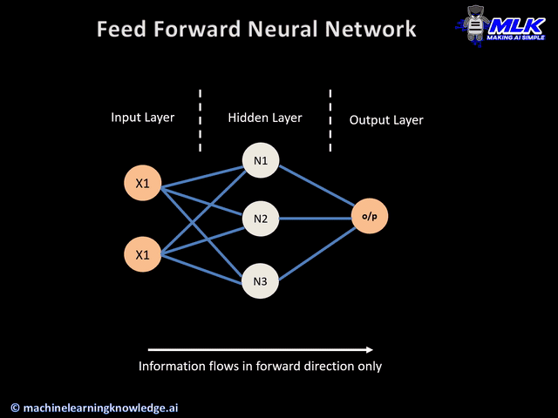
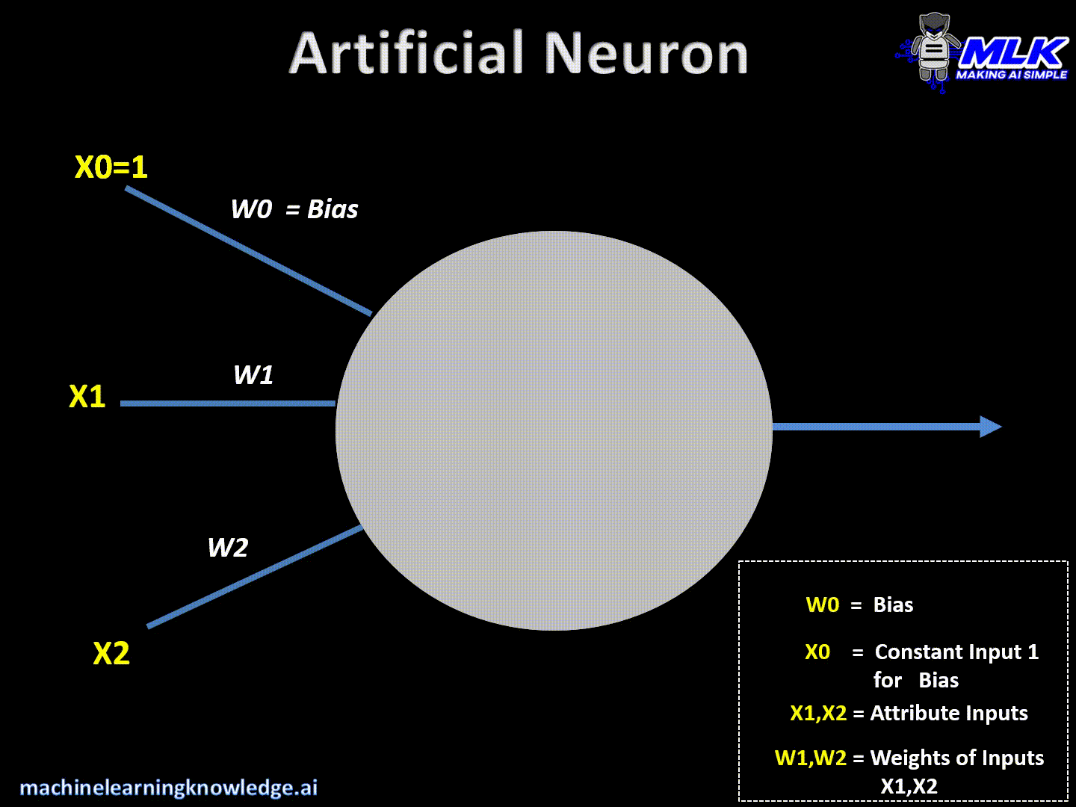
Neuron
Neural Network
A Neuron

Slide 8
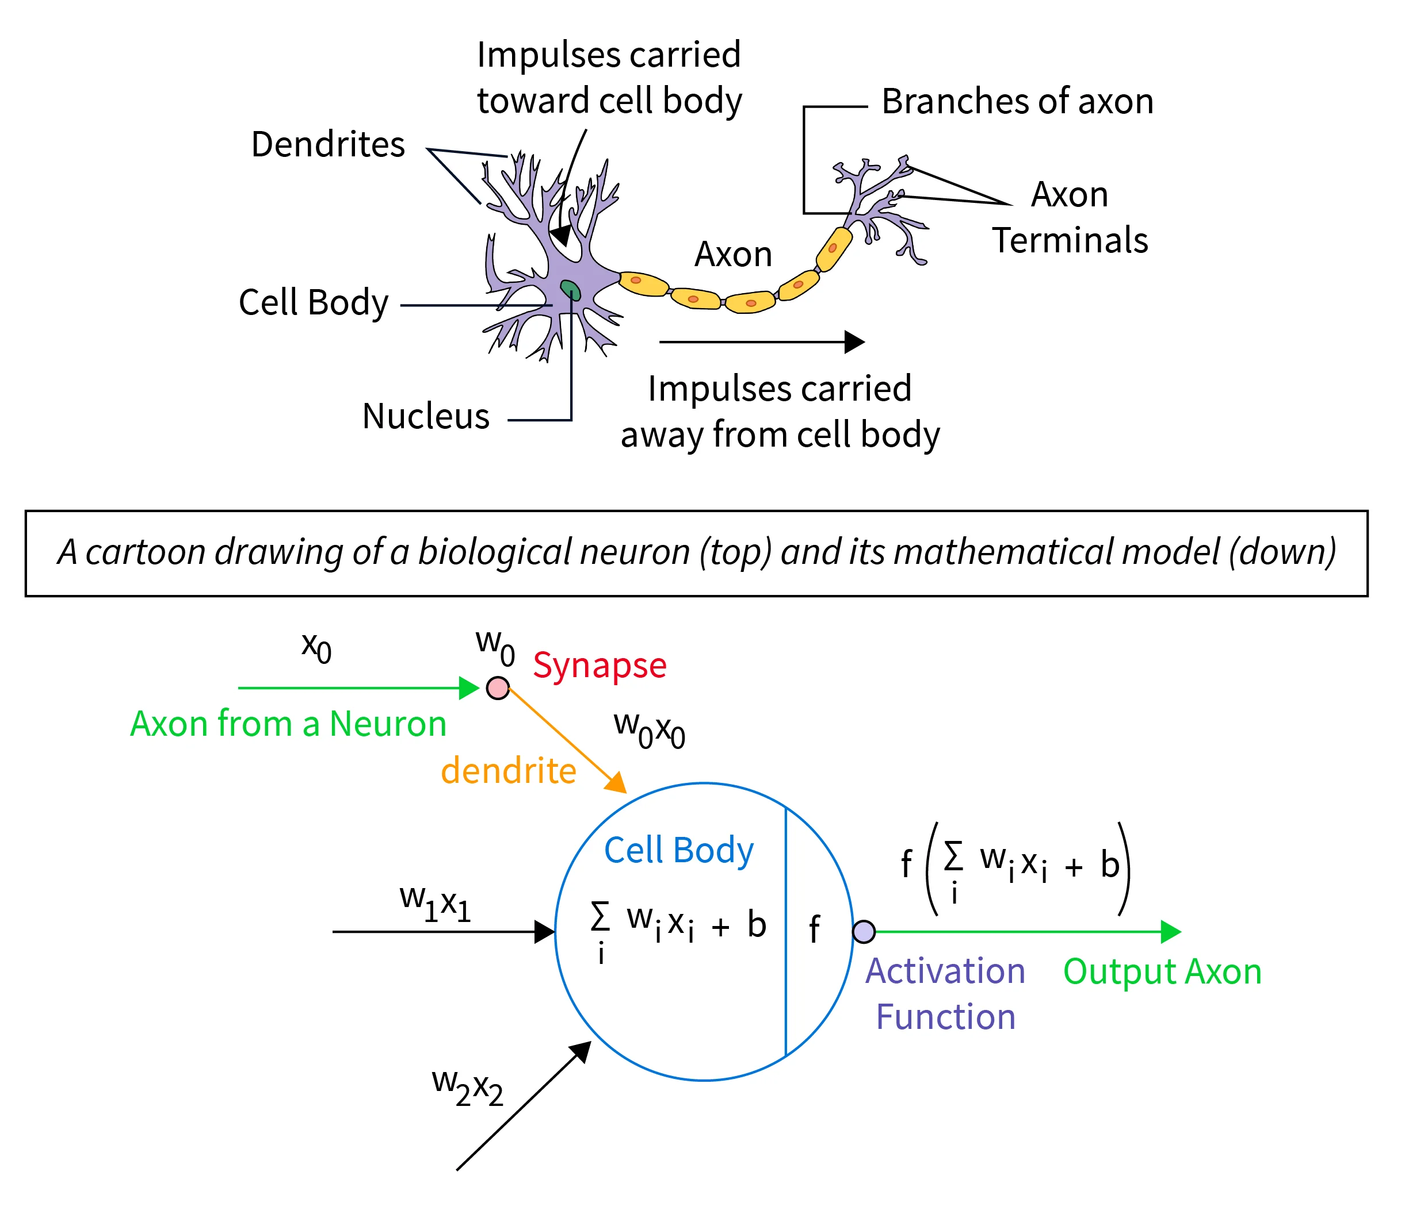
Notes:
Weighted sum of input → Affine transformation or transform function → defines the boundary of the plane
Activation function → sigmoid function/ReLU
Loss function (Not inside neuron, but for training)

Slide 9
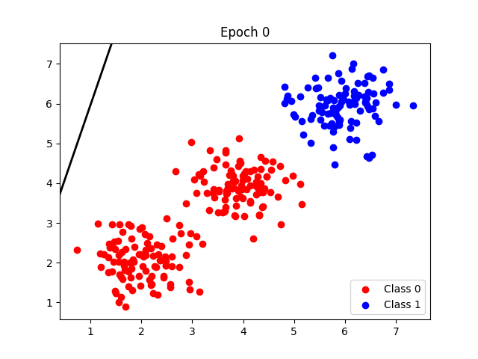
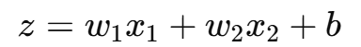
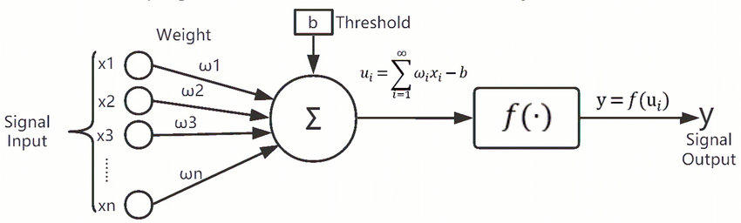
Single Neuron
Notes:
σ(x)=1/(1+ e^-x)

Slide 10
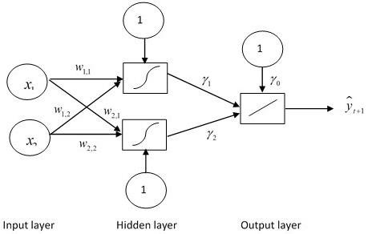
Two Neurons
What is your expectation?

Slide 11
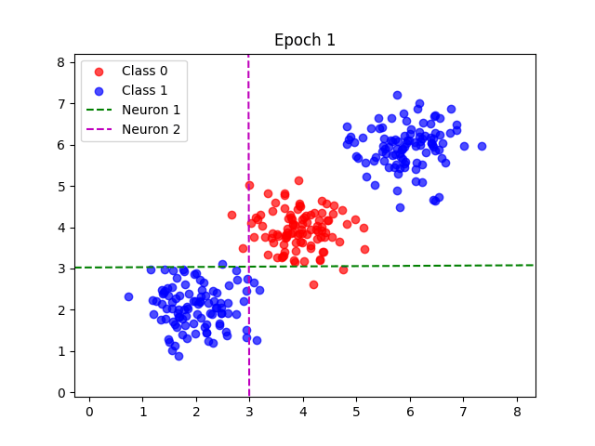
Two Neurons
What is your expectation?

Slide 12
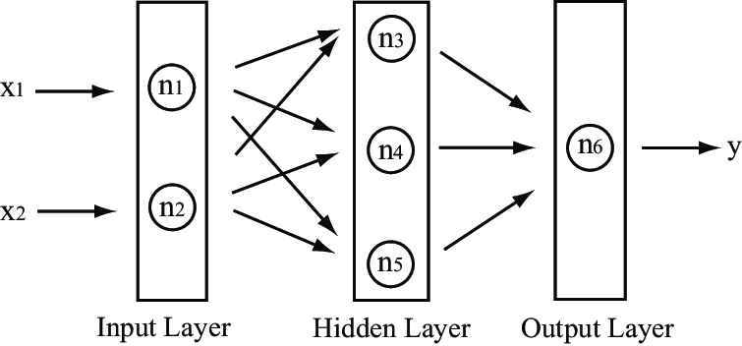
Three Neurons
What is your expectation?

Slide 13
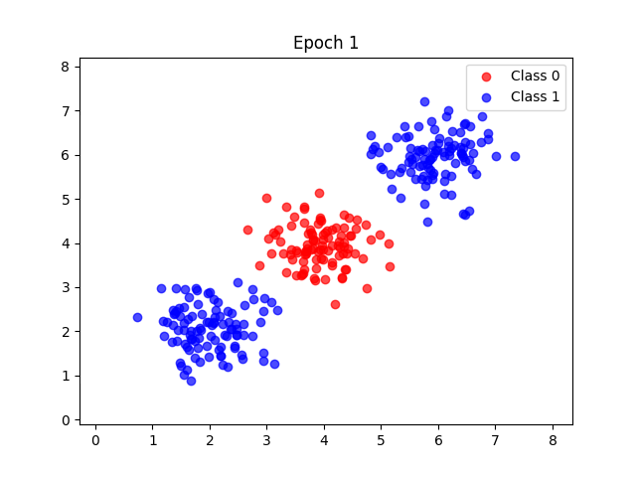
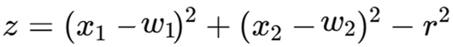

Circular Neuron
Circle centered at ($w_{1},w_{2}$) with radius r

Slide 14
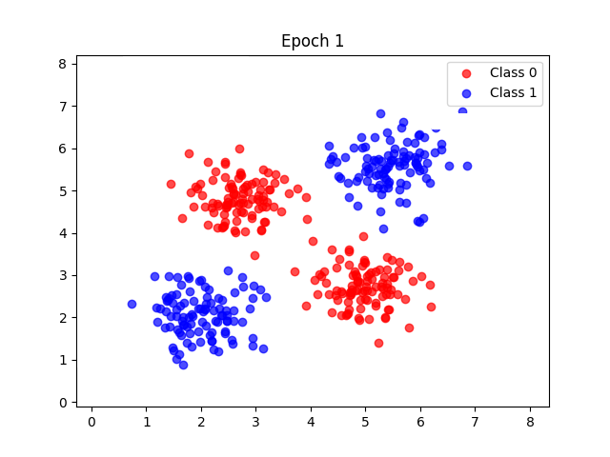
Circular Neuron
So conclusion
We can say we needs multiple neuron for more accurate learning
Enough data and time to train
Selection of boundary line is important
So how to learn non-linear data
Notes:
AGI refers to Artificial General Intelligence

Slide 15
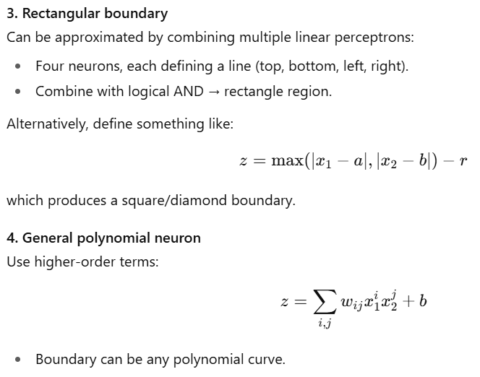
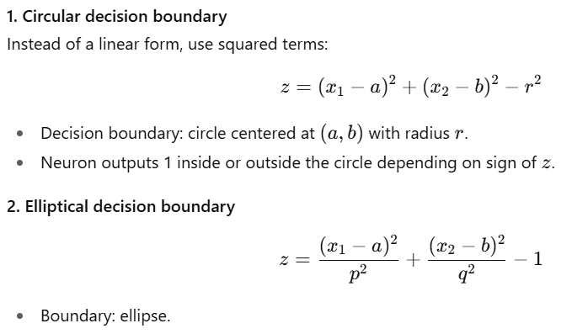
Non-linear Perceptron

Slide 16
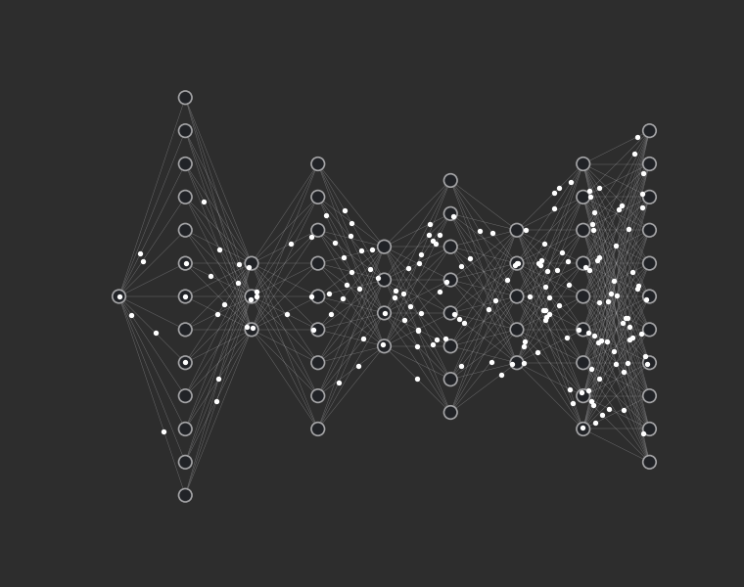

Multi-Layer
And on that note, I'll stop talking before you all fall asleep
Le Audience

Slide 17

Thank You
BUT a DEMO is well deserved

Slide 18

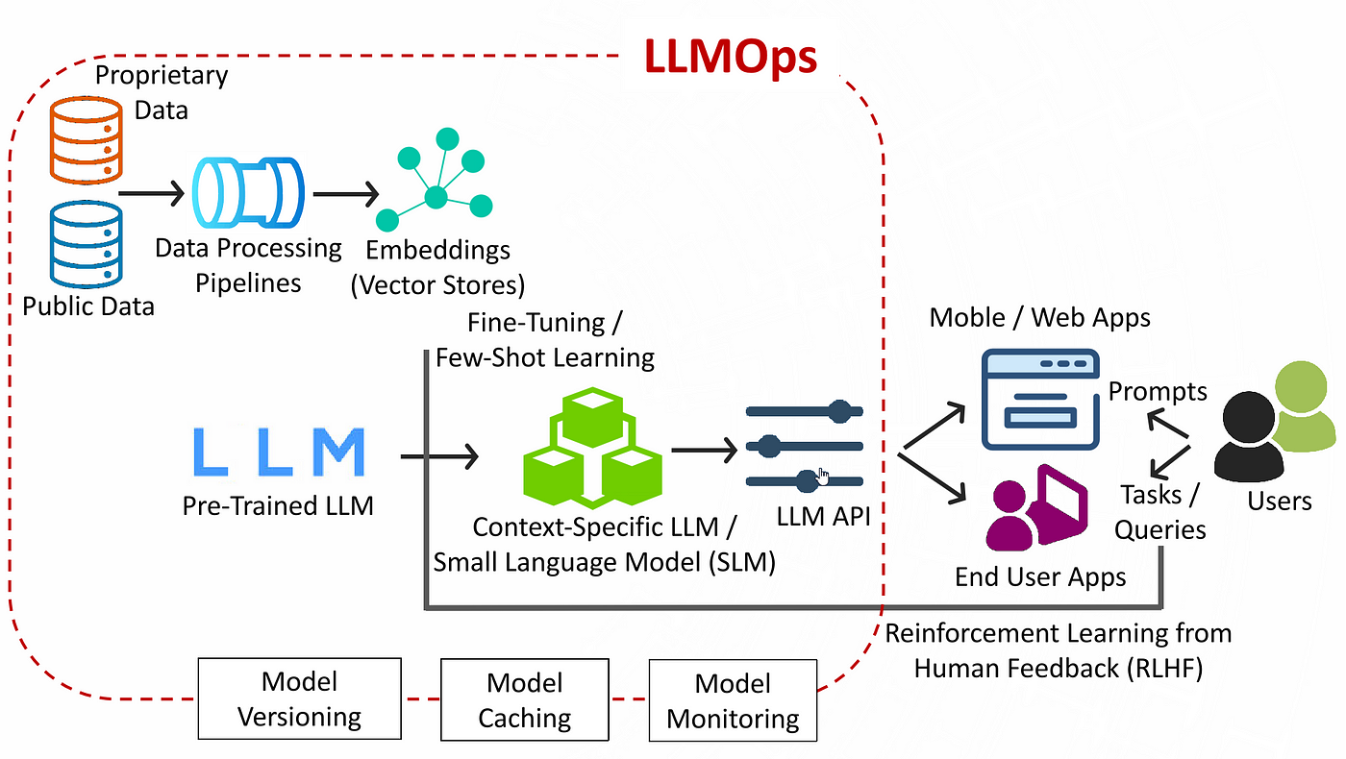

LLM: Ignore diagram, it's just to scare you all
ONE MORE SLIDE

Slide 19


Thank You
Dilip Kumar Shrestha

